Slide 1
Ch.9 Terahertz Optics
Lee Jong Geon

Slide 2
Contents
Terahertz Optical Materials
Metal Reflectivities
Gaussian Optics
Dichroic Optical Elements
Wire-Grid Polarizers
Antireflection Coatings
Photonic Crystal Fibers and Terahertz Waveguides

Slide 3
Terahertz Optical Materials

Slide 4
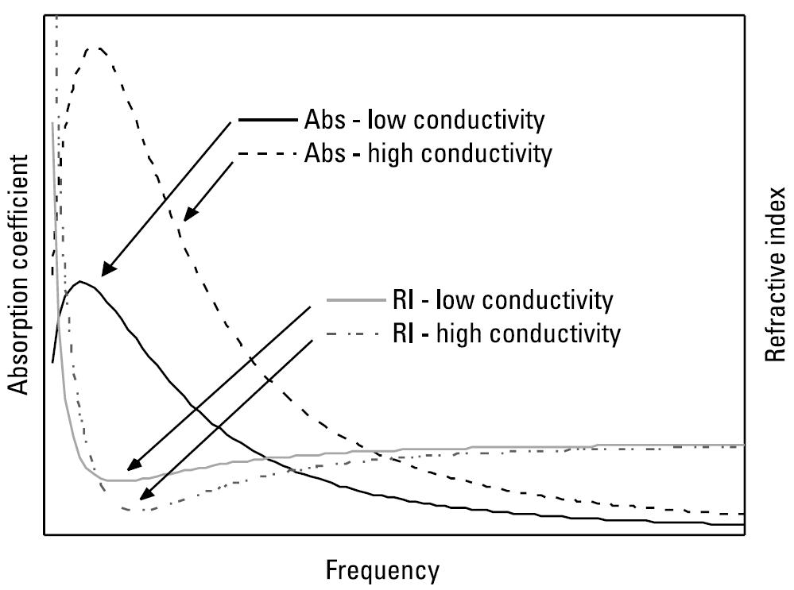
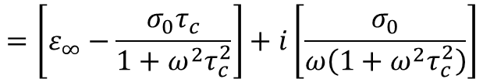

1.1 Transparency at Terahertz Frequencies
Material absorption at terahertz frequencies arises from several mechanisms
Free Carrier Absorption
Frequency-dependent absorption by free carriers may be generally described by the Drude model of carrier transport
$$ε=ε^{′}+ε^{′′}=ε_{∞}+i\frac{σ\left(ω\right)}{ω}=ε_{∞}+\frac{iσ_{0}}{ω\left(1−iωτ_{c}\right)}$$
$$=\left[ε_{∞}−\frac{σ_{0}τ_{c}}{1+ω^{2}τ_{c}^{2}}\right]+i\left[\frac{σ_{0}}{ω\left(1+ω^{2}τ_{c}^{2}\right)}\right]$$
0.1~0.5 THz

Slide 5

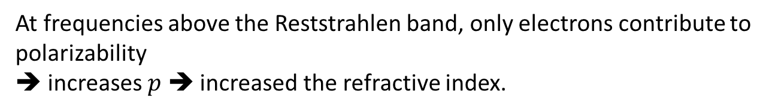
1.1 Transparency at Terahertz Frequencies
Absorption by Lattice Modes (Phonons)
Resonant absorption of radiation occurs when the frequency of the incident terahertz wave matches that of vibrational modes (phonons) of the lattice.
Reststrahlen bands: Some materials possess very intense phonon resonances clustered in broad frequency bands.
$$\frac{ε_{r}−1}{ε_{r}+2}=\frac{Np}{2ε_{0}}$$
At frequencies above the Reststrahlen band, only electrons contribute to polarizability
➔ increases $p$ ➔ increased the refractive index.

Slide 6
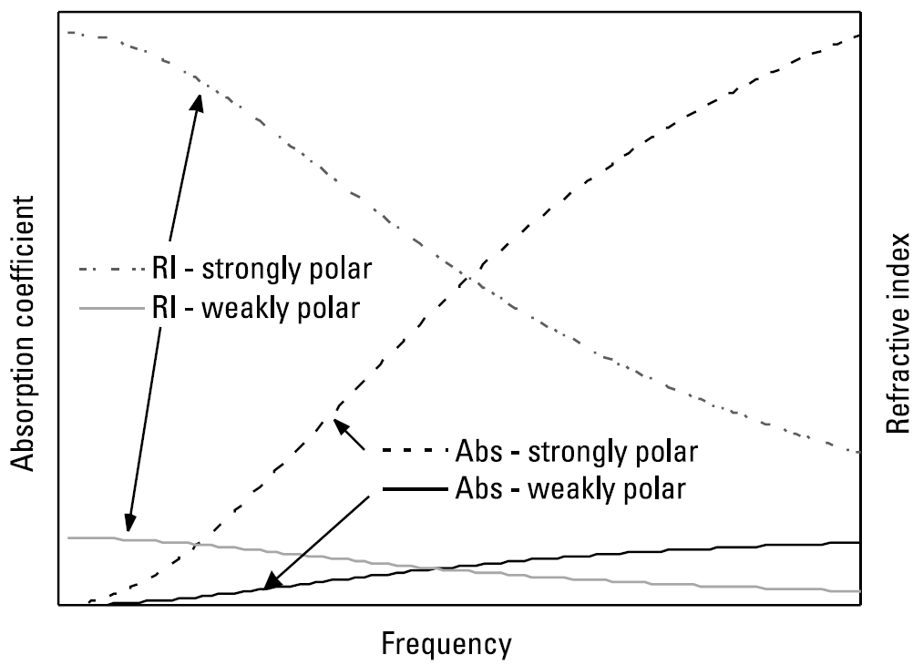
1.1 Transparency at Terahertz Frequencies
Dielectric Relaxations in Polar Materials
At higher frequencies the diploe motions are impeded by friction in the material, in consequence of which their response is delayed relative to the field, manifesting as absorption.

Slide 7
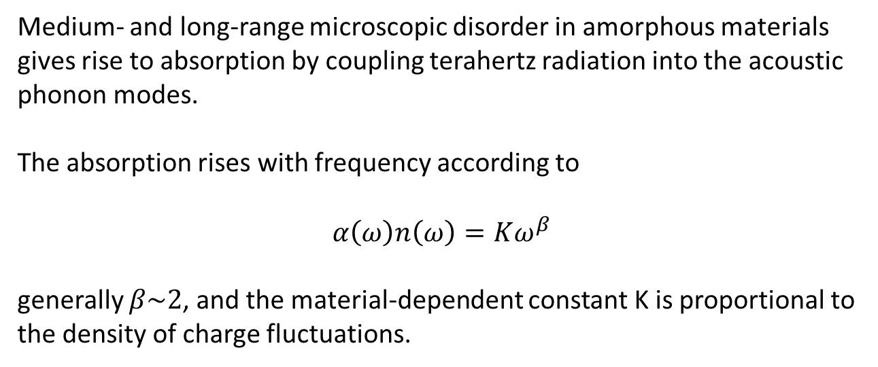
1.1 Transparency at Terahertz Frequencies
Disorder-Induced Absorption in Amorphous Materials
Medium- and long-range microscopic disorder in amorphous materials gives rise to absorption by coupling terahertz radiation into the acoustic phonon modes.
The absorption rises with frequency according to
$$α\left(ω\right)n\left(ω\right)=Kω^{β}$$
generally $β\sim 2$, and the material-dependent constant K is proportional to the density of charge fluctuations.

Slide 8
1.2 Inorganic Crystals for Terahertz Optics
Silicon
High resistivity float-zone silicon is the premier optical material for terahertz frequencies owing to its very low absorption and negligible dispersion from below 0.1 to ~13 THz
Resistivity: ~ 10kΩ cm ➔ high terahertz transparency
Good mechanical strength
Phonon resonance high frequency (18.4 THz)
Refractive index: 3.42
Germanium
Similar to silicon in many respects
Resistivity: ~ 50Ω cm ➔ limited at low frequencies by Drude absorption
Range: 1 ~ 8 THz, phonon resonance 9 THz
Refractive index: ~ 4

Slide 9
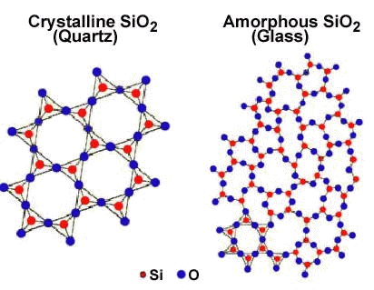
1.2 Inorganic Crystals for Terahertz Optics
Quartz (SiO₂)
strong covalent ➔ only weakly polar, allowing it to have good terahertz transparency in the lower part of the band.
Birefringent and anisotropic ➔ z-cut
Refractive index: ~ 2.12
Low absorption up to 3THz
Phonon resonance: 4 THz
Reststrahlen band edge: ~ 7THz
➔ Unsuitable for terahertz optics
Sapphire (Al₂O₃)
More polar than quartz and therefore has a lower terahertz transparency.
Birefringent and anisotropic ➔ z-cut
Terahertz absorption increases rapidly with frequency ➔ cannot be used above 2THz
Refractive index: ~ 3.1

Slide 10
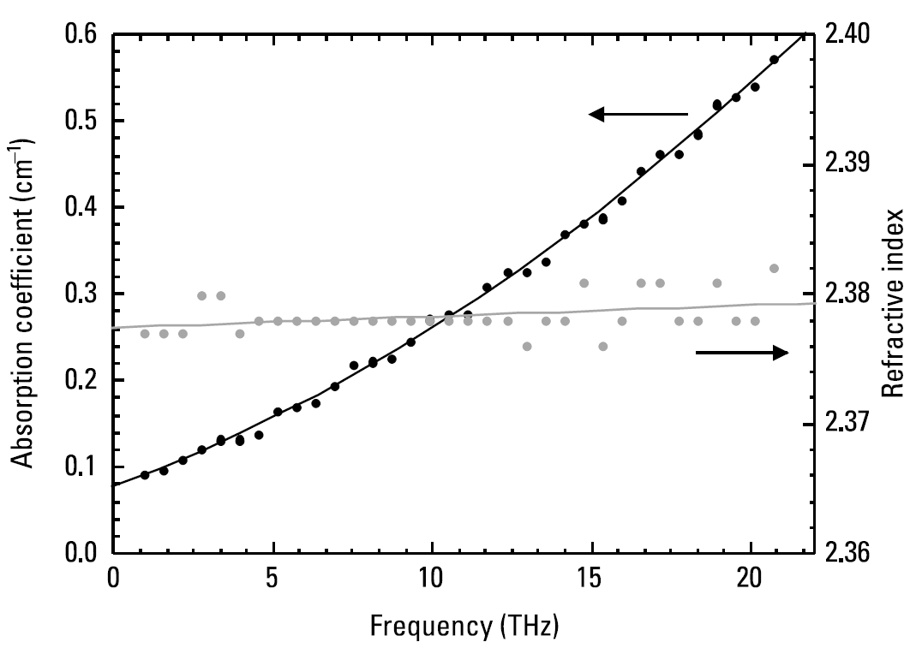
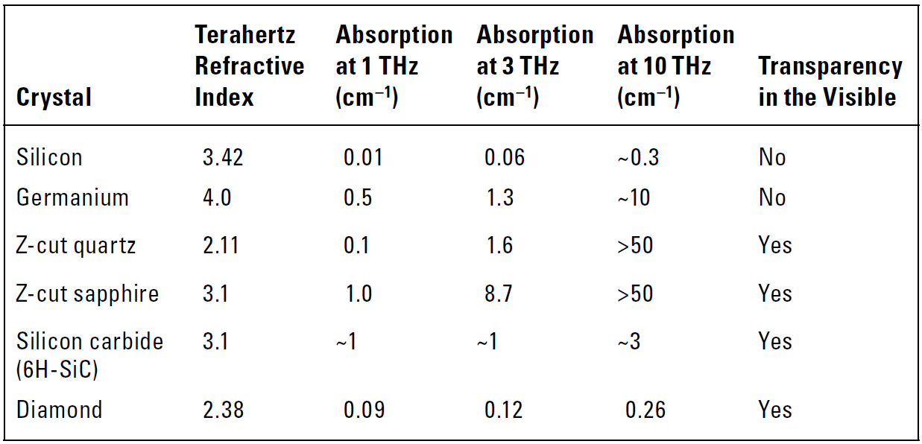
1.2 Inorganic Crystals for Terahertz Optics
Diamond
Diamond is an excellent terahertz optical material, however its use limited by its high cost and the difficulty of fabricating shapes other than thin wafers
phonon absorption: 60THz
Silicon Carbide (SiC)
SiC appears to be highly promising as a material for terahertz optics
Reststrahlen band: 20 ~ 30 THz
Refractive index: ~ 3.1

Slide 11
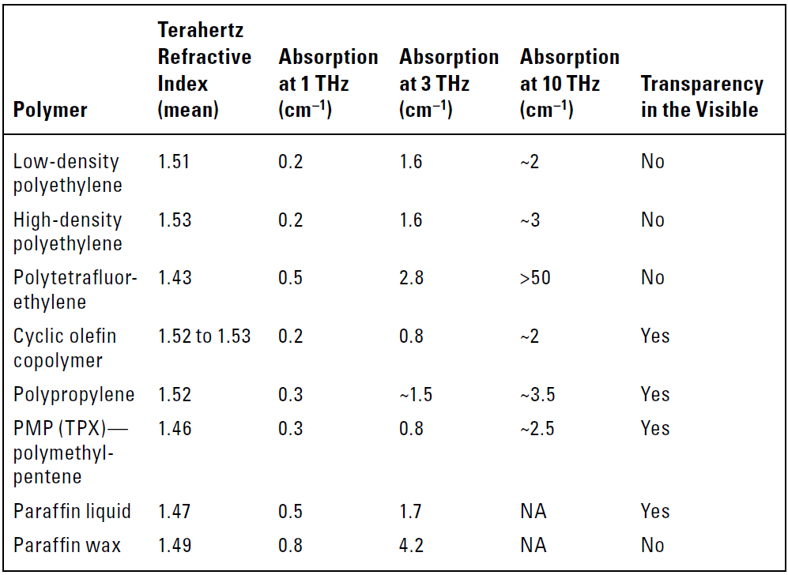
1.3 Polymers for Terahertz Optics

Slide 12
Metal Reflectivities

Slide 13
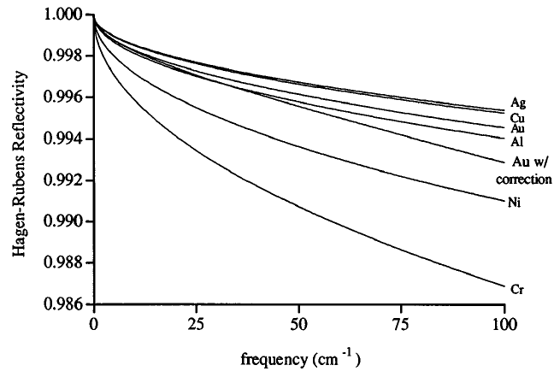
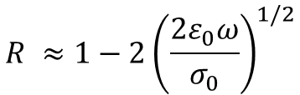
2. Metal Reflectivities
Metallic mirrors are arguably the most crucial components of any terahertz system.
The power reflectivity of a good conductor:
$$R ≈1−2{\left(\frac{2ε_{0}ω}{σ_{0}}\right)}^{1/2}$$
➔ Reflectivity $∝$ Conductivity
Gatesman, A. J., R. H. Giles, and J. Waldman, “High-Precision Reflectrometer for Submillimeter Wavelength,” J. Opt. Soc. Am. B, Vol. 12, 1995.

Slide 14
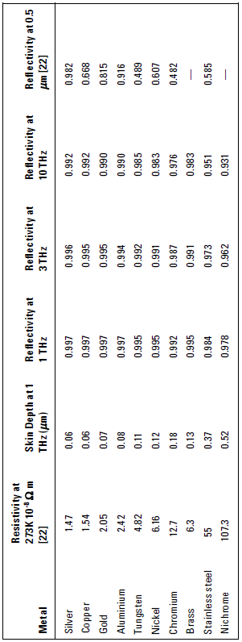

2. Metal Reflectivities
The thickness of the metal coating on a mirror must be sufficiently large
➔ It must be capable of containing the currents induced by the interaction with the electromagnetic field.
$$δ=\sqrt{\frac{2}{ωμ_{0}σ_{0}}}$$

Slide 15
Gaussian Optics

Slide 16
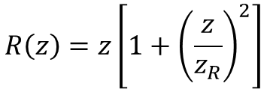
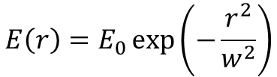
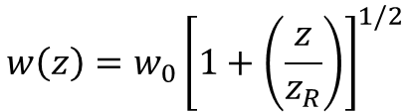

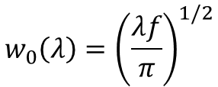
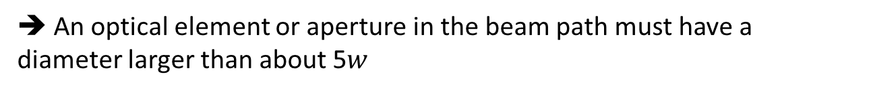
3.1 Gaussian Beams
Radiation in the terahertz band has wavelength that are comparable to the sixe of the optical components.
The Gaussian bean radial distribution
$$E\left(r\right)=E_{0}\exp\left(−\frac{r^{2}}{w^{2}}\right)$$
➔ An optical element or aperture in the beam path must have a diameter larger than about 5$w$
The minimum radius of the beam waist
$$w_{0}\left(λ\right)={\left(\frac{λf}{π}\right)}^{1/2}$$
Rayleigh length
$$z_{R}\left(λ\right)=\frac{πw_{0}^{2}}{λ}$$
Beam waist & wavefront radius
$$w\left(z\right)=w_{0}{\left[1+\left(\frac{z}{z_{R}}\right)\right]}^{1/2}$$
$$R\left(z\right)=z\left[1+{\left(\frac{z}{z_{R}}\right)}^{2}\right]$$

Slide 17
Dichroic Optical Element

Slide 18
4.1 Terahertz Transparent/Visible Opaque
It is often necessary to combine visible and terahertz beams so that they copropagate, or to remove or redirect one of the beams
Expanded polymer foams
In many ways, polymer foams fulfill best the required criteria
➔ Low frequency-independent terahertz loss, low refractive index, low beam distortion, high loss in the visible, low cost
Nonpolar polyemrs (HDPE, PTFE)
( + ): Higher mechanical strength, can be formed in to lenses
( - ): Higher transmission loss than foams
High-resistivity silicon
( + ): The lowest terahertz absorption over the greastest bandwidth
( - ): Sufficiently high optical intensities the concentration of generated photocarriers can produce significant terahertz absorption.

Slide 19
4.2 Terahertz Opaque/Visible Transparent
Optical glasses have strong terahertz absorption.
➔ BK7, pure SiO₂
Glass has several important advantages for this role
➔highly transparent, distortion-free optical windows, antireflection coating does not affect its performance
Other materials: Perspex (polymethylmethacrylate), polystyrene, polar crystals (LiNbO₃, TiO₂)

Slide 20

4.3 Terahertz Reflective/Visible Transparent
Visible transparent conductive coatings can act as reflective surfaces for terahertz radiation.
$$ωτ_{c}≪σ_{0}$$
In metals relaxation times (10^{–18} s) ➔ ultraviolet.
In transparent conductors relaxation times(10^{–14} s) ➔ terahertz
&reflectivity decreases steeply in the visible
One of the best-known transparent conductors that has been studied and used as a terahertz reflector is indium-tin-oxide (ITO)

Slide 21
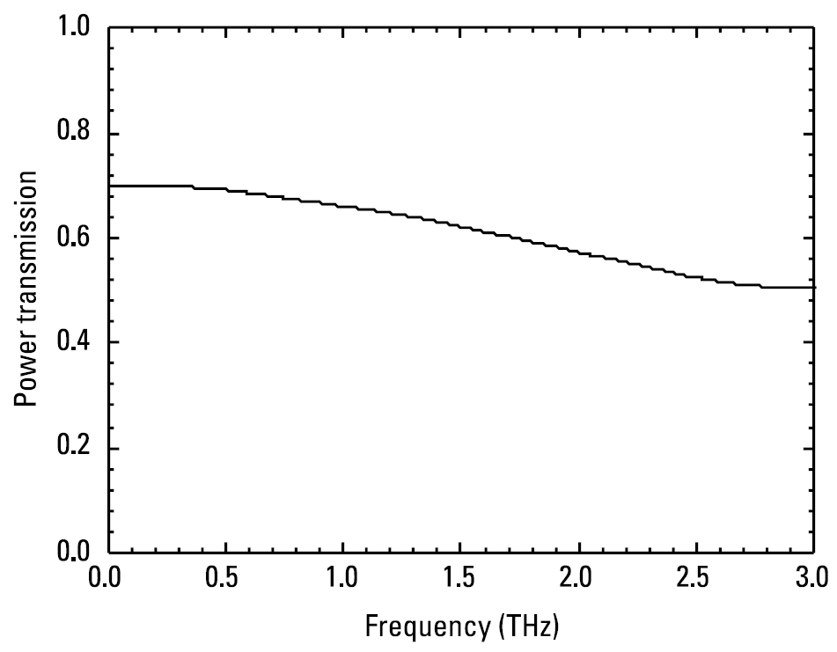
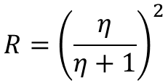

4.4 Terahertz Transparent/Visible Reflective
Such films are semitransparent to terahertz beams and are semi-reflective in the visible
Visible freq. skin depth <Film thickness< Terahertz freq. skin depth
$$R={\left(\frac{η}{η+1}\right)}^{2}$$
$$η=\frac{nk}{2}\frac{d}{δ}$$
TPX (Polymethylpentene)
- Reflectivity of approximately 80% in the visible

Slide 22
Wire-Grid Polarizers

Slide 23
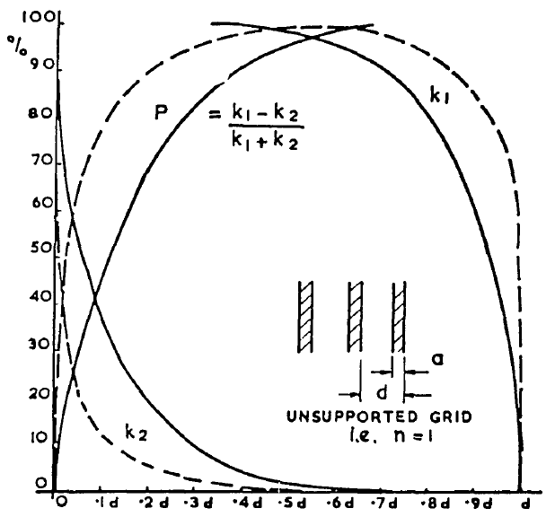
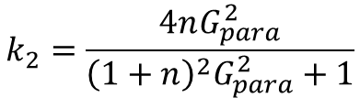
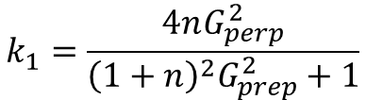

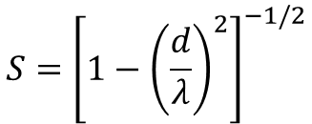




5. Wire-Grid Polarizers
Wire-grid polarizers perform excellently in terms of broad bandwidth, high polarization extinction ratio and low transmission loss, and many refinements on the design have been demonstrated.
$$k_{1}=\frac{4nG_{perp}^{2}}{{\left(1+n\right)}^{2}G_{prep}^{2}+1}$$
$$d=2a$$
$$k_{2}=\frac{4nG_{para}^{2}}{{\left(1+n\right)}^{2}G_{para}^{2}+1}$$
$$G_{prep}≈\frac{λ}{d}\frac{1}{4S}$$
$$G_{prep}≈\frac{d}{λ}S$$
$$S={\left[1−{\left(\frac{d}{λ}\right)}^{2}\right]}^{−1/2}$$
$$λ/d=5$$
$λ/d=$10
Auton, J. P., “Infrared Transmission Polarizers by Photolithography,” App. Opt., Vol. 6, 1967.

Slide 24
Antireflection Coatings

Slide 25
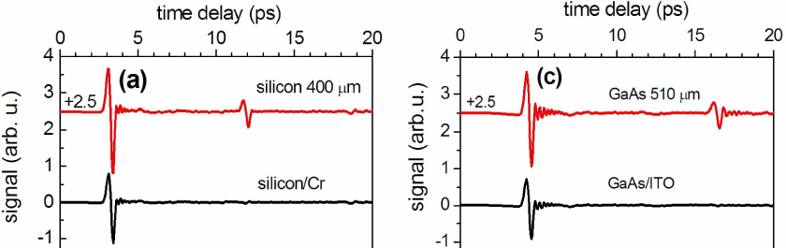

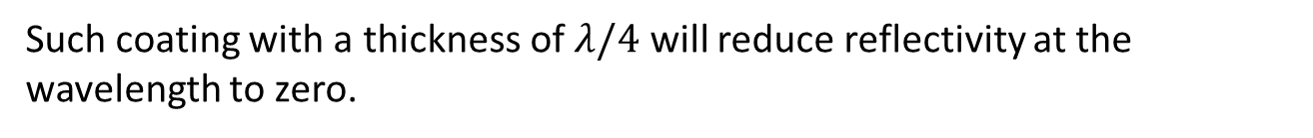
6. Antireflection Coatings
High-resistivity silicon and nonlinear crystals (GaAs, ZnTe) have terahertz refractive indices in excess of 3, giving rise to severe Fresnel losses.
Dielectric Films
$$n_{AR}^{2}=n_{substrate}$$
Such coating with a thickness of $λ/4$ will reduce reflectivity at the wavelength to zero.
Conductive Impedance Matching Coatings
Conductive layers of chromium and ITO on Si, GaAs, and GaP have demonstrated good antireflective properties up to about 4 THz
Microstructure Surfaces
Structures are difficult to produce, and the resulting surfaces are susceptible to damage and contamination.
Broeng, J., “Photonic Crystal Fibers: A New Class of Optical Waveguides,” Opt. Fiber Tehc., Vol. 5, 1999.

Slide 26
Photonic Crystal Fibers and
Terahertz Waveguides

Slide 27
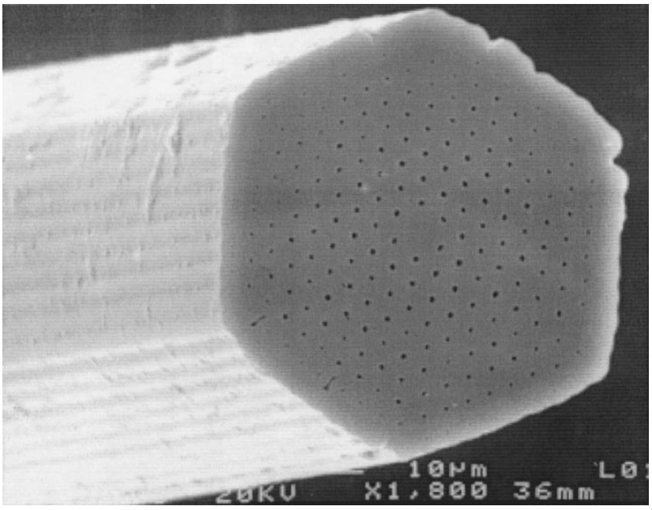
7. Photonic Crystal Fibers and Terahertz Waveguides
Many terahertz applications would benefit greatly from the ability to deliver terahertz radiation over fiber. However, terahertz fiber design is made very problematic due to the lack of suitable transparent materials.
Photonic Crystal Fibers (PCFs)
Only specific wave-vectors can propagate through the fiber structure
Can be designed to have zero dispersion and single-mode transmission over a very broad bandwidth.
Broeng, J., “Photonic Crystal Fibers: A New Class of Optical Waveguides,” Opt. Fiber Tehc., Vol. 5, 1999.

Slide 28
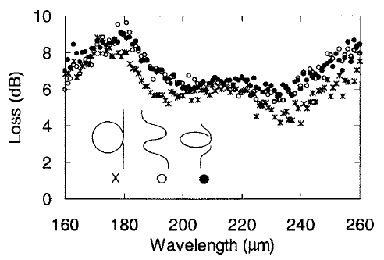
7. Photonic Crystal Fibers and Terahertz Waveguides
Hollow Tube Fibers
Terahertz waveguiding using hollow tube pipes has been demonstrated with both uncoated tubes and tubes containing internal metal coatings.
Uncoated tubes: PTFE (0.005 dB/cm at 0.4 THz)
Internal metal coatings: Polycarbonate tube coated with Cu (0.05 dB/cm at 2.5 THz), Thin-walled glass coated with Ag (6 dB at 0.67 THz)
Kröll, J., J. Darmo, and K. Unterrainer, “Metallic Wave-Impedance Matching Layers for Broadband Terahertz Optical Systems,” Opt. Exp., Vol. 15, 2007.

Slide 29
References
Auton, J. P., “Infrared Transmission Polarizers by Photolithography,” App. Opt., Vol. 6, 1967, pp. 1023-1027.
Broeng, J., “Photonic Crystal Fibers: A New Class of Optical Waveguides,” Opt. Fiber Tehc., Vol. 5, 1999, pp. 305-330.
Gatesman, A. J., R. H. Giles, and J. Waldman, “High-Precision Reflectometer for Submillimeter Wavelength,” J. Opt. Soc. Am. B, Vol. 12, 1995, pp. 212-219.
Ito, T., et al., “Flexible Terahertz Fiber Optics with Low Bend-Induced Losses,” J. Opt. Soc. Am. B, Vol. 24, 2007, pp. 1230-1235.
Kröll, J., J. Darmo, and K. Unterrainer, “Metallic Wave-Impedance Matching Layers for Broadband Terahertz Optical Systems,” Opt. Exp., Vol. 15, 2007, pp. 6552-6560.

